Slide 1
Plugfest project – Shadow Proxy
Presenter
Ryuichi Matsukura, Fujitsu Limited

Slide 2
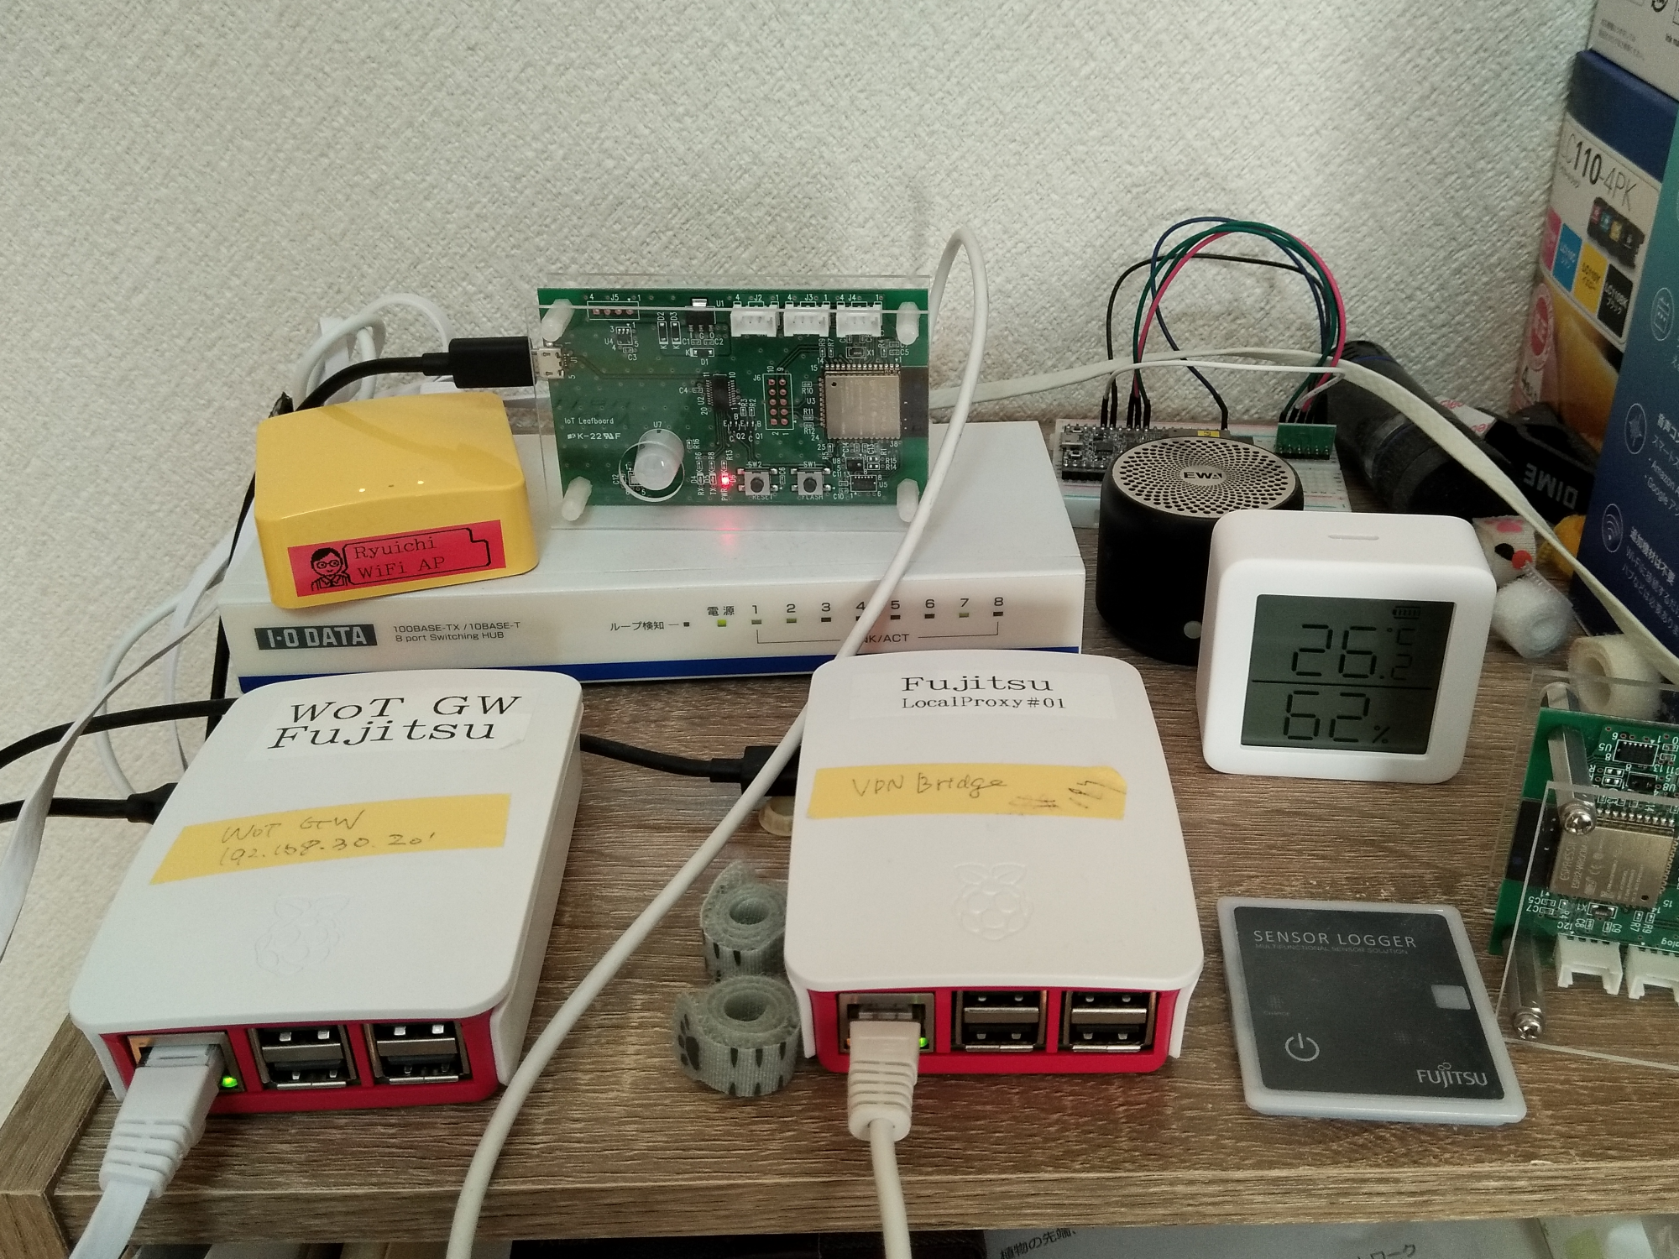
Diagram in this plugfest
Fujitsu provides three services
Sensor unit (temperature, humidity and air pressure)
Proxy server
Application
192.168.30.xx
192.168.30.128
Application
(curl, nodeRED)
192.168.0.xx
Fujitsu local
Internet
Plugfest VPN
Proxy server
192.168.30.134
192.168.0.201
device
device
Sensor unit
192.168.0.18

Slide 3
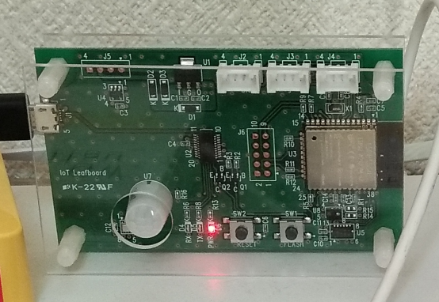
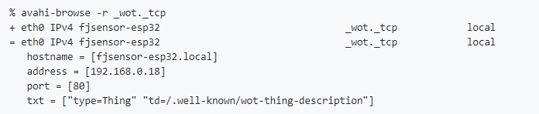
Sensor unit
3 sensors: temperature, humidity and air pressure
ESP32 with Wi-Fi
Developed in C++ using Arduino
mDNS support

Slide 4
Proxy server
Objectives
prevent direct access to real devices.
allow multiple devices connected with different protocols and authentication methods to connect using one protocol and one authentication method.
Shadow device
are created on request from real device
exposes the endpoint to applications instead of real device

Slide 5
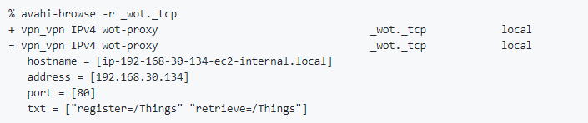
Proxy server (2)
Developed in JAVA on RaspberryPi (Linux)
Advertising the proxy address to real devices and applications with mDNS

Slide 6




APIs of Proxy server
Registration and unregistration of shadow devices
Getting a list of registered shadows
Retrieving shadow TDs and real TDs
Search APIs are NOT implemented.
APIs to search for devices with their description and attributes as a key

Slide 7
Results: checked devices
4 devices are connected (Internet, VPN and local)
Fujitsu sensor can find the proxy and register own TD to it automatically
Others are register manually
All devices can be controlled from the application on the VPN via the proxy
192.168.30.xx
192.168.30.128
Application
(curl, nodeRED)
192.168.0.xx
Internet
Plugfest VPN
Proxy server
Fujitsu local
192.168.30.134
192.168.0.201
device
device
Sensor unit
192.168.0.18
counter(Siemens)
hitachi-led(Hitachi)
fjsensor(Fujitsu)
temperaturesensor(ECHONET)

